Slide 1
Movie Store - Project Report
Jack Gallagher and Ryan Hassell
Github Link: https://github.com/JackGallagher41/MovieDatabase

Slide 2
All of our Pages
Login Page
Register Page
Home Page
Review Page
Cart
Movie Info Page

Slide 3
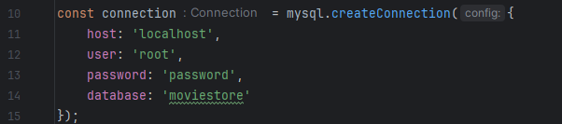
How to set up the environment
After you’ve cloned the repository, make a MySQL schema called “moviestore”
Then, run “npm install” in the terminal in the project window to install the project’s dependencies.
After that, run “node build” to add all of the movies and tables to your MySQL database.
Finally, run “node server” to start the Node JS server.
Launch “login.html” to register your user. Feel free to login and explore the page!
Note: make sure you change these variables to fit your MySQL workbench. —>

Slide 4
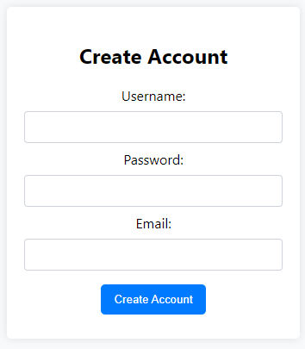
Functionalities - Register Page
Makes sure username is unique
Takes a email, username and passcode attaching it to a user id
Redirects to login page once user is created
Makes sure that all fields have something input
Adds the created user into the users table

Slide 5
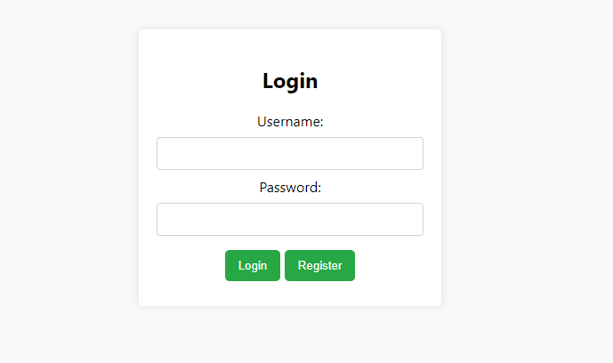
Functionalities - Login Page
Button that takes you to registration if you don’t already have an account
Ability to put in your username and password to log you in
Once logged in through this page you will be session tracked throughout the website
If user does not exist, a client will be informed that there is an invalid username or password
Logging in will send you over to the home page

Slide 6
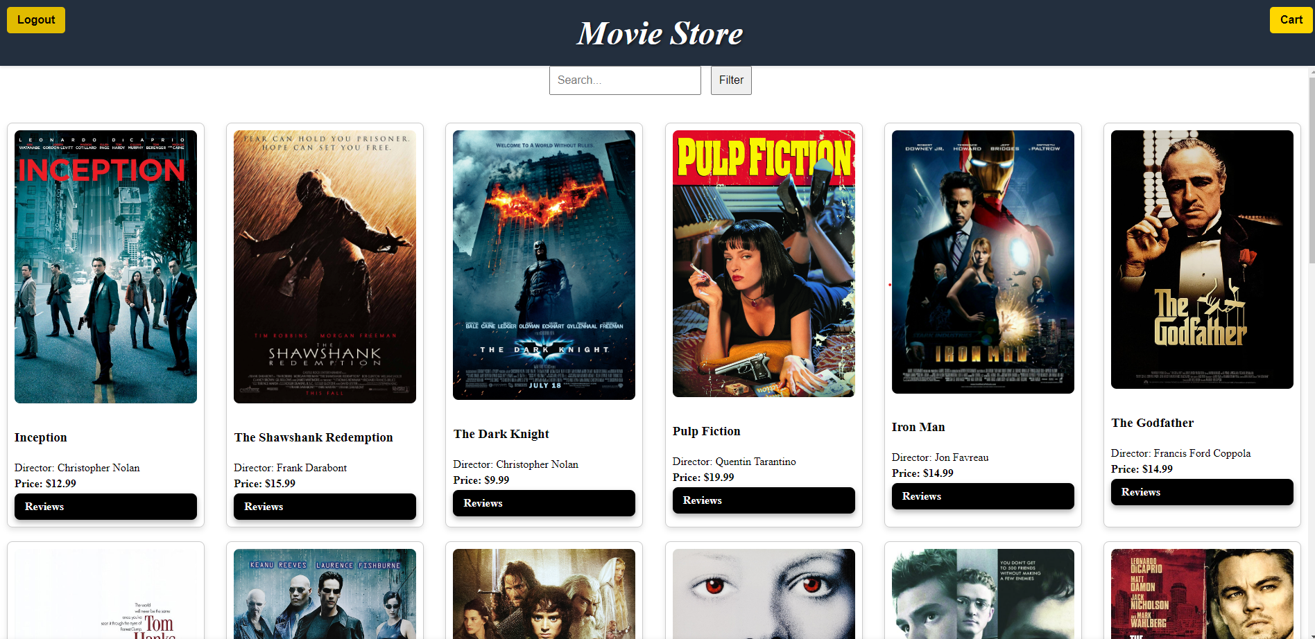
Functionalities - Home Page
Provides a list of movies for the user to browse through
Given the option to search the title narrowing it down based on the title
Each movie has a review button directing them to that movies personal reviews page
Displays the movies title director and price with the option to click it to enter the movie info page
Displays images for each movie
Logout button takes user out of session track and redirects to login page
Cart button that redirects user to their personal cart

Slide 7
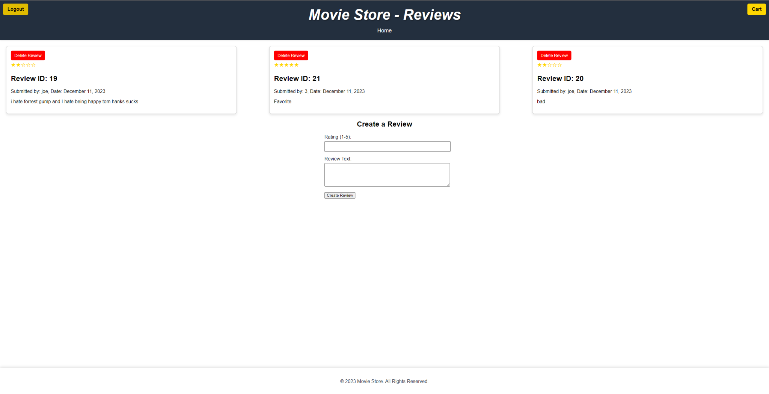
Functionalities - Reviews Page
Allows the user to see all of the published reviews for each movie
Each movie has its own reviews.
Reviews can be created and deleted.
Reviews can only be deleted by the user who created them.

Slide 8
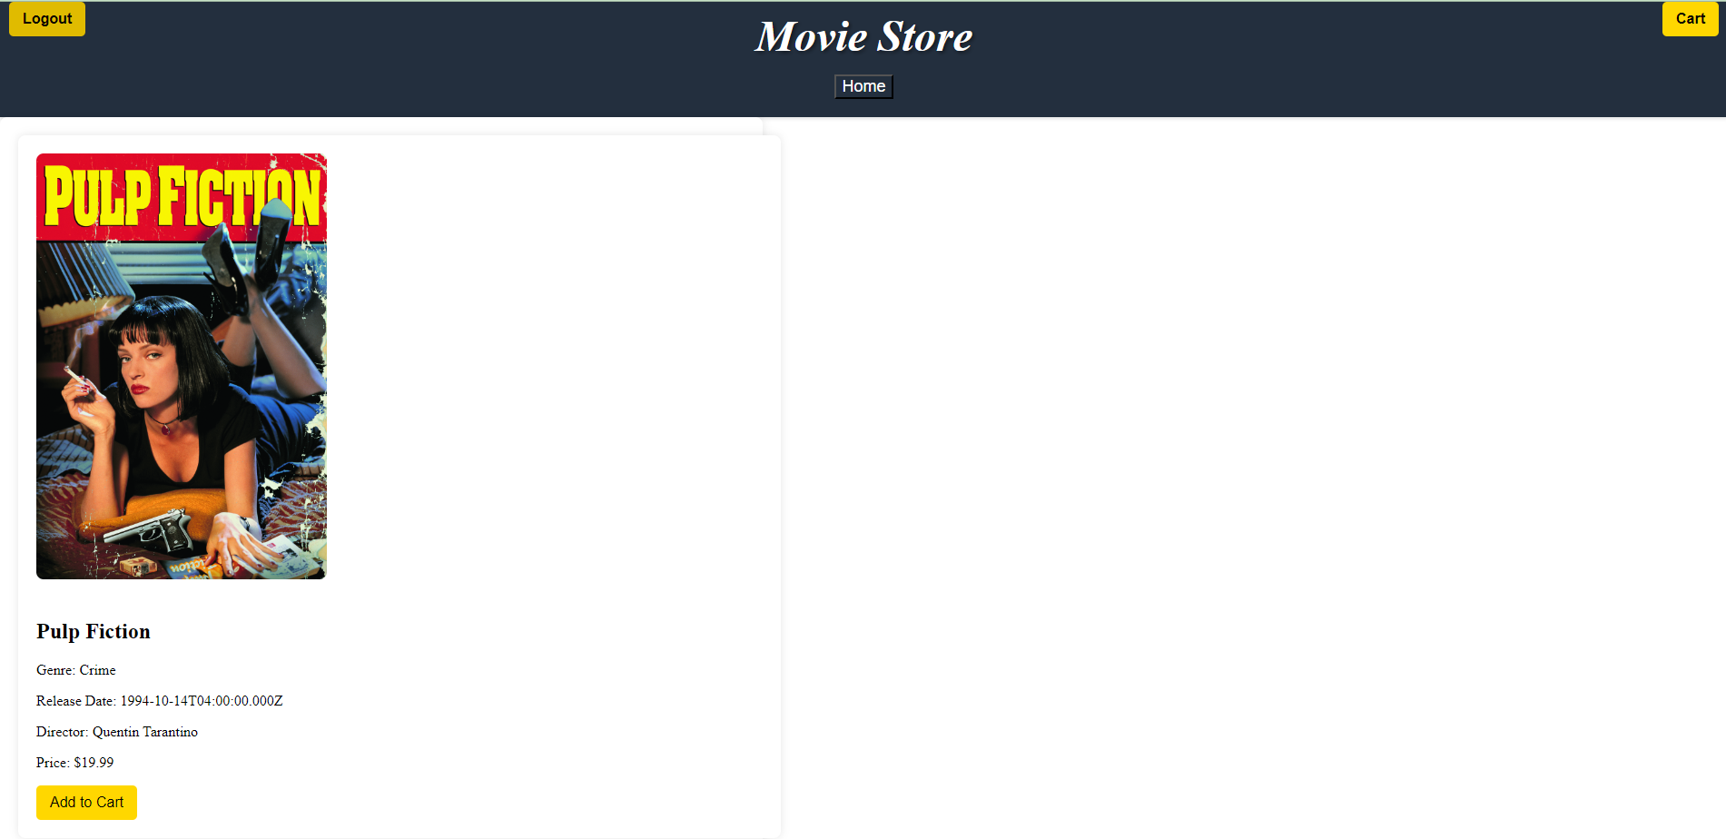
Functionalities - Movie Info Page
Displays the movie along with its title price director and release date
Gives you the ability to add movie into the users cart
Logout button takes user out of session track and redirects to login page
Cart button that redirects user to their personal cart
Home button that redirects user back to the main page

Slide 9
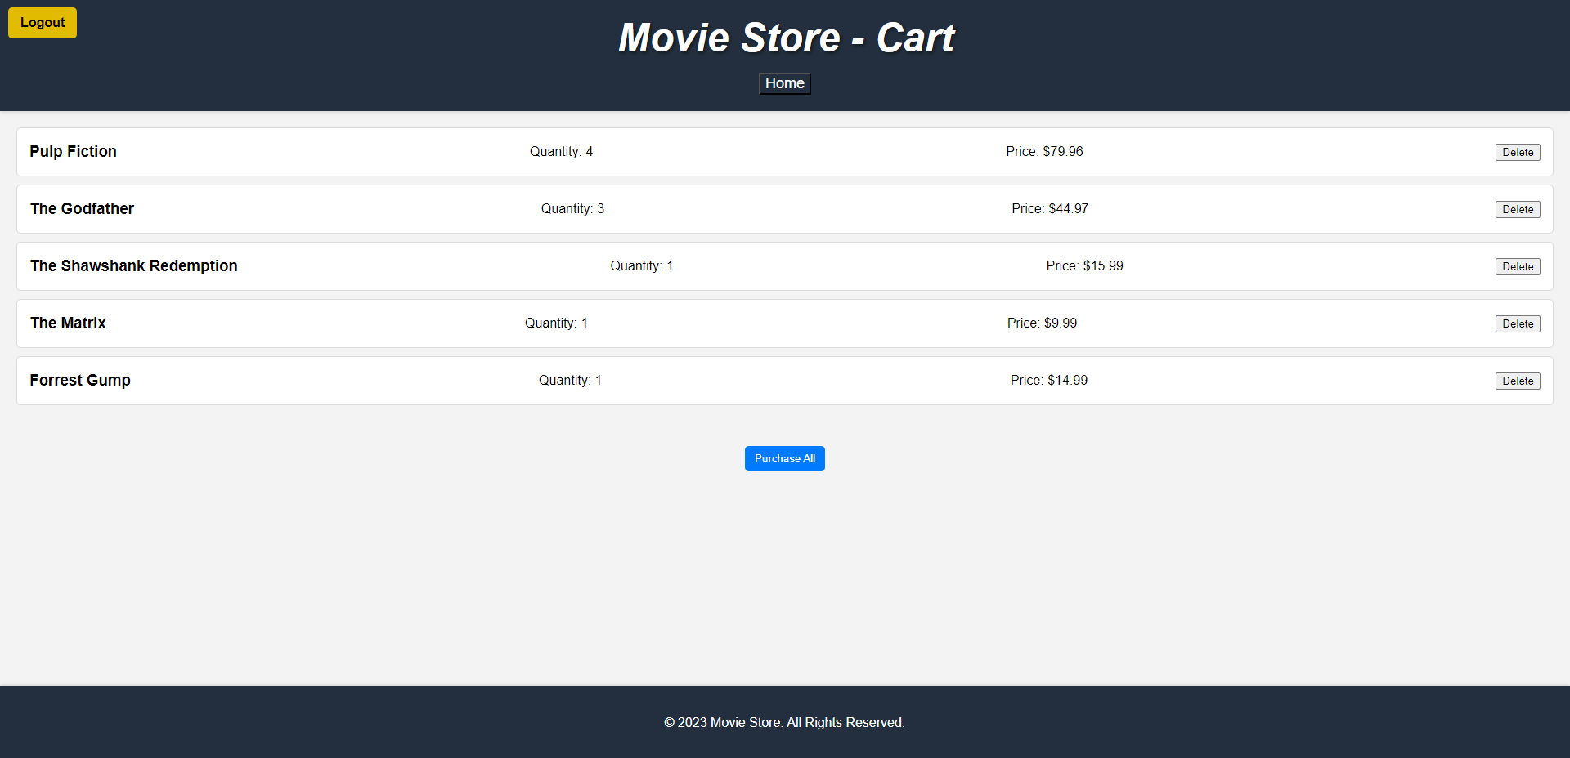
Functionalities - Cart Page
Displays all the users cart information
Gives user the ability to delete something that was place in their cart
Gives user the ability to buy all, sending them to the home page and deleting everything in their cart
Displays the price of each as well as the quantity (if multiple items it will multiply quantity by the movies price)
Logout button takes user out of session track and redirects to login page
Home button that redirects user back to the main page

Slide 10
List of all Select, Insert Into, Update and Deletes
Get movies: Select (lists all movies, used to display the movies)
Get movies with id:Select (gets all movies based off movies id, used for review specification)
Add to cart: Select, insert into and update (If user already has one in cart the quantity will be update, select to check and insert into if not already in user’s cart)
Get reviews: Select (retrieves all reviews for a movie based on movie id, used to display reviews)
Add reviews: Insert Into (creates a new review adding to review table)
Get Users: Select (gets a user by their id, used anytime a session tracking is needed)
List Users: Select (gets a list of all users)
Create Users: Insert Into (creates a new user in register)
Select cart with user_ID: Select (used to get users personal cart)
Cart delete: Delete (deletes an item from cart, no check needed cause button)
Cart Purchase all: Delete (Delete all items from cart)
Review delete: Delete, Select (checks for review based on id and deletes that review)

Slide 11
Statement Ranking - Jack / 50%
Task 1: I designed the EER model
Task 2: Created the html and some javascript for register and login
Task 3: Developed the entirety of the carts page including the rest apis, the display and the javascript
Task 4:Developed the entirety of the info page including rest apis, display and the javascript
Task 5: Created and developed the Home Page button, Logout button and Cart button throughout the website
Task 6: Created some change to the tables in build.js like adding restrictions, adding columns and changing some names
Task 7: Worked on Login and Registration pages creating forms, the display and some javascript as well
Task 8: Did a lot of bug fixing throughout every file
Task 9: did session tracking between many of the files
Task 10: designed the relational model

Slide 12
Statement Ranking - Ryan / 50%
I did the entirety of the reviews page, including:
REST APIs for creating, getting, and deleting reviews.
JavaScript for handling the information received and sent to and from these requests.
HTML for the web-pages.
The star display for reviews (proud of this one)
For the login and register pages, I created the REST APIs for logging in and registering. I also created the pages in HTML and created the JavaScript for the pages.
I also created the Home Page, its JS, added each movie, and got each movie to display as its own, separate, clickable entity (with a cool shadow and animation). I also created the REST apis for this as well. (Getter for movies.)
Connected the back-end and front-end

Slide 13
Statement Ranking - Sean / 0%
Never joined github

Slide 14
Relational Model and ER Diagram
In github

